Slide 1
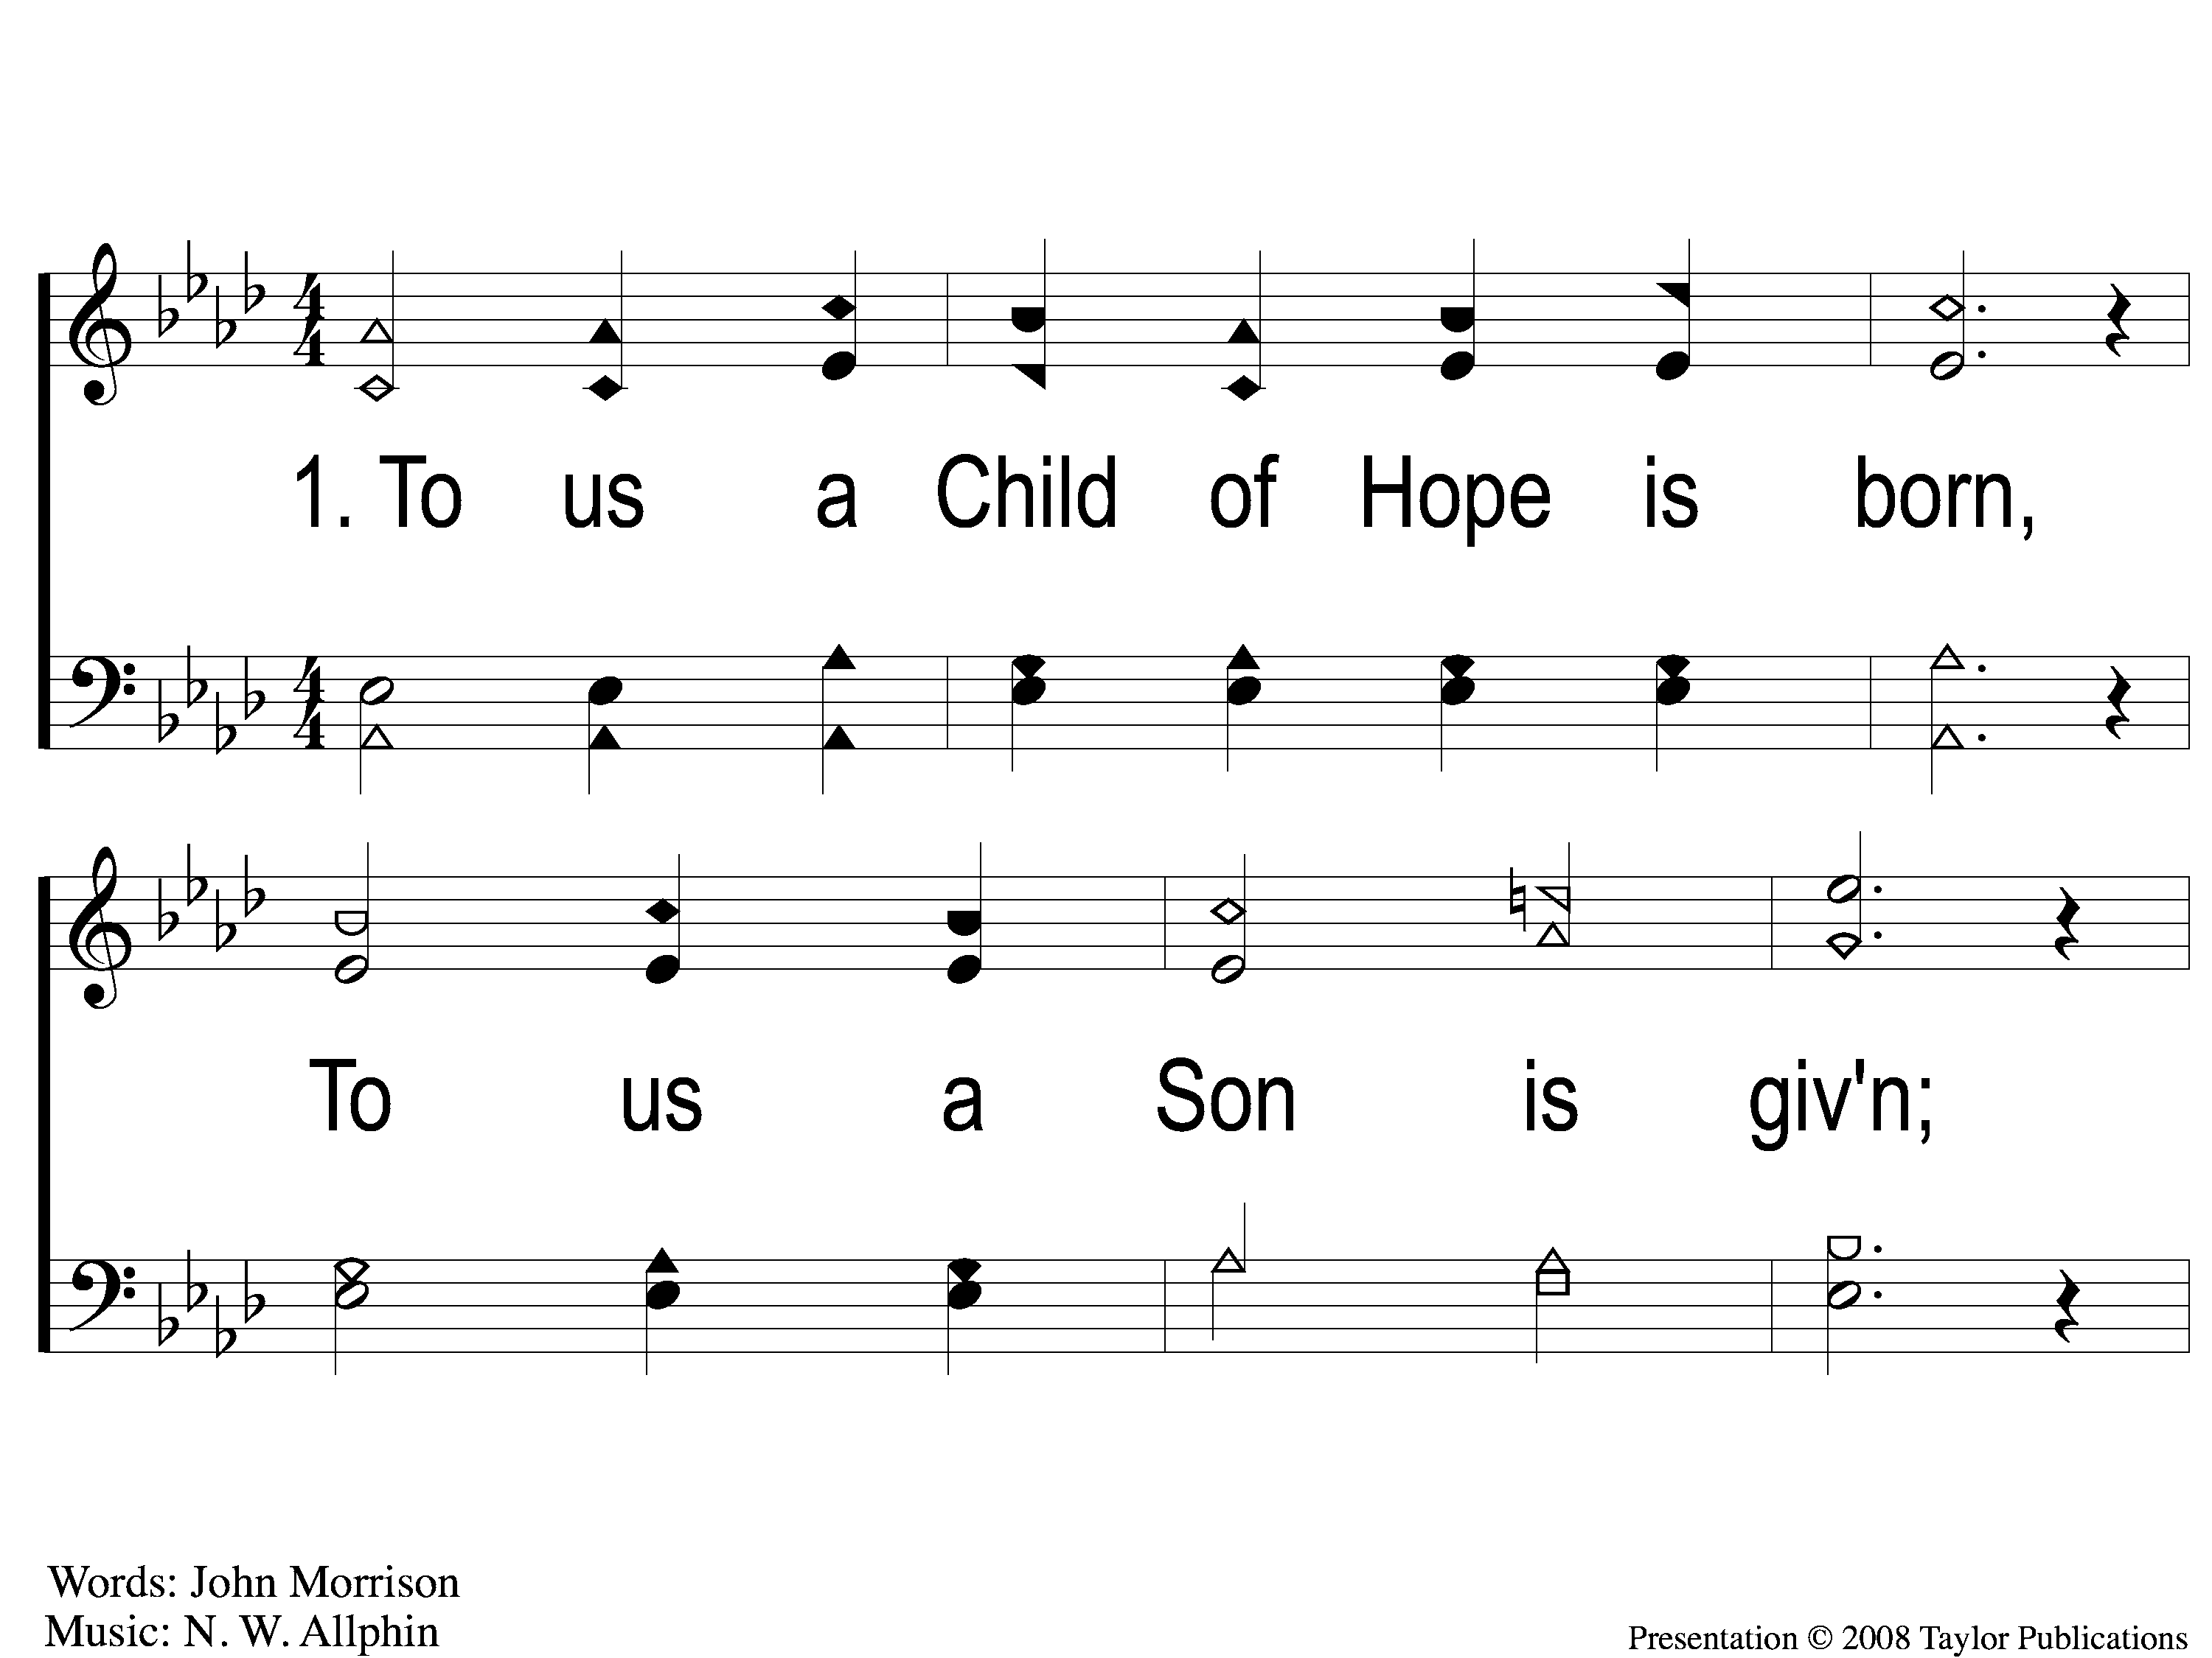
1-1 The Prince of Peace
The Prince of Peace
49

Slide 2
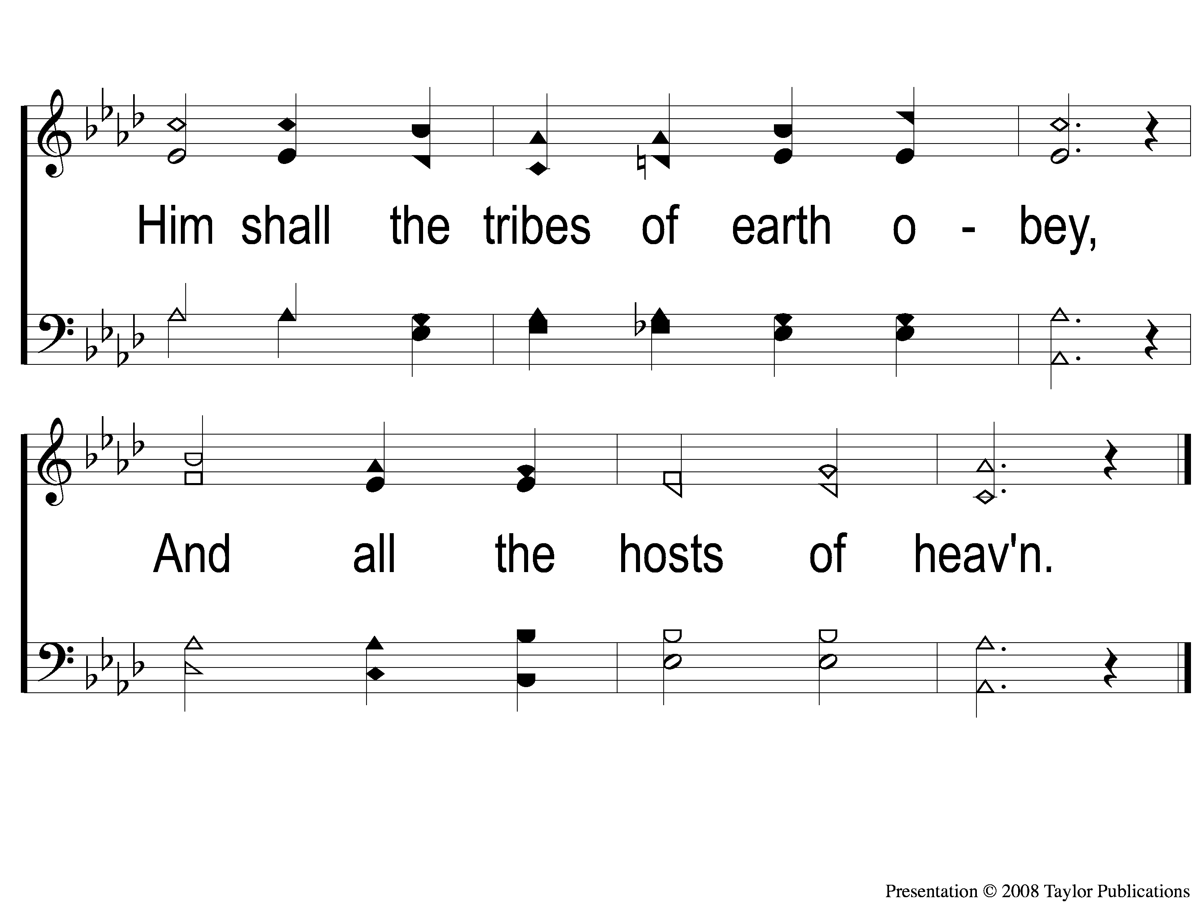
1-2 The Prince of Peace
The Prince of Peace
49

Slide 3
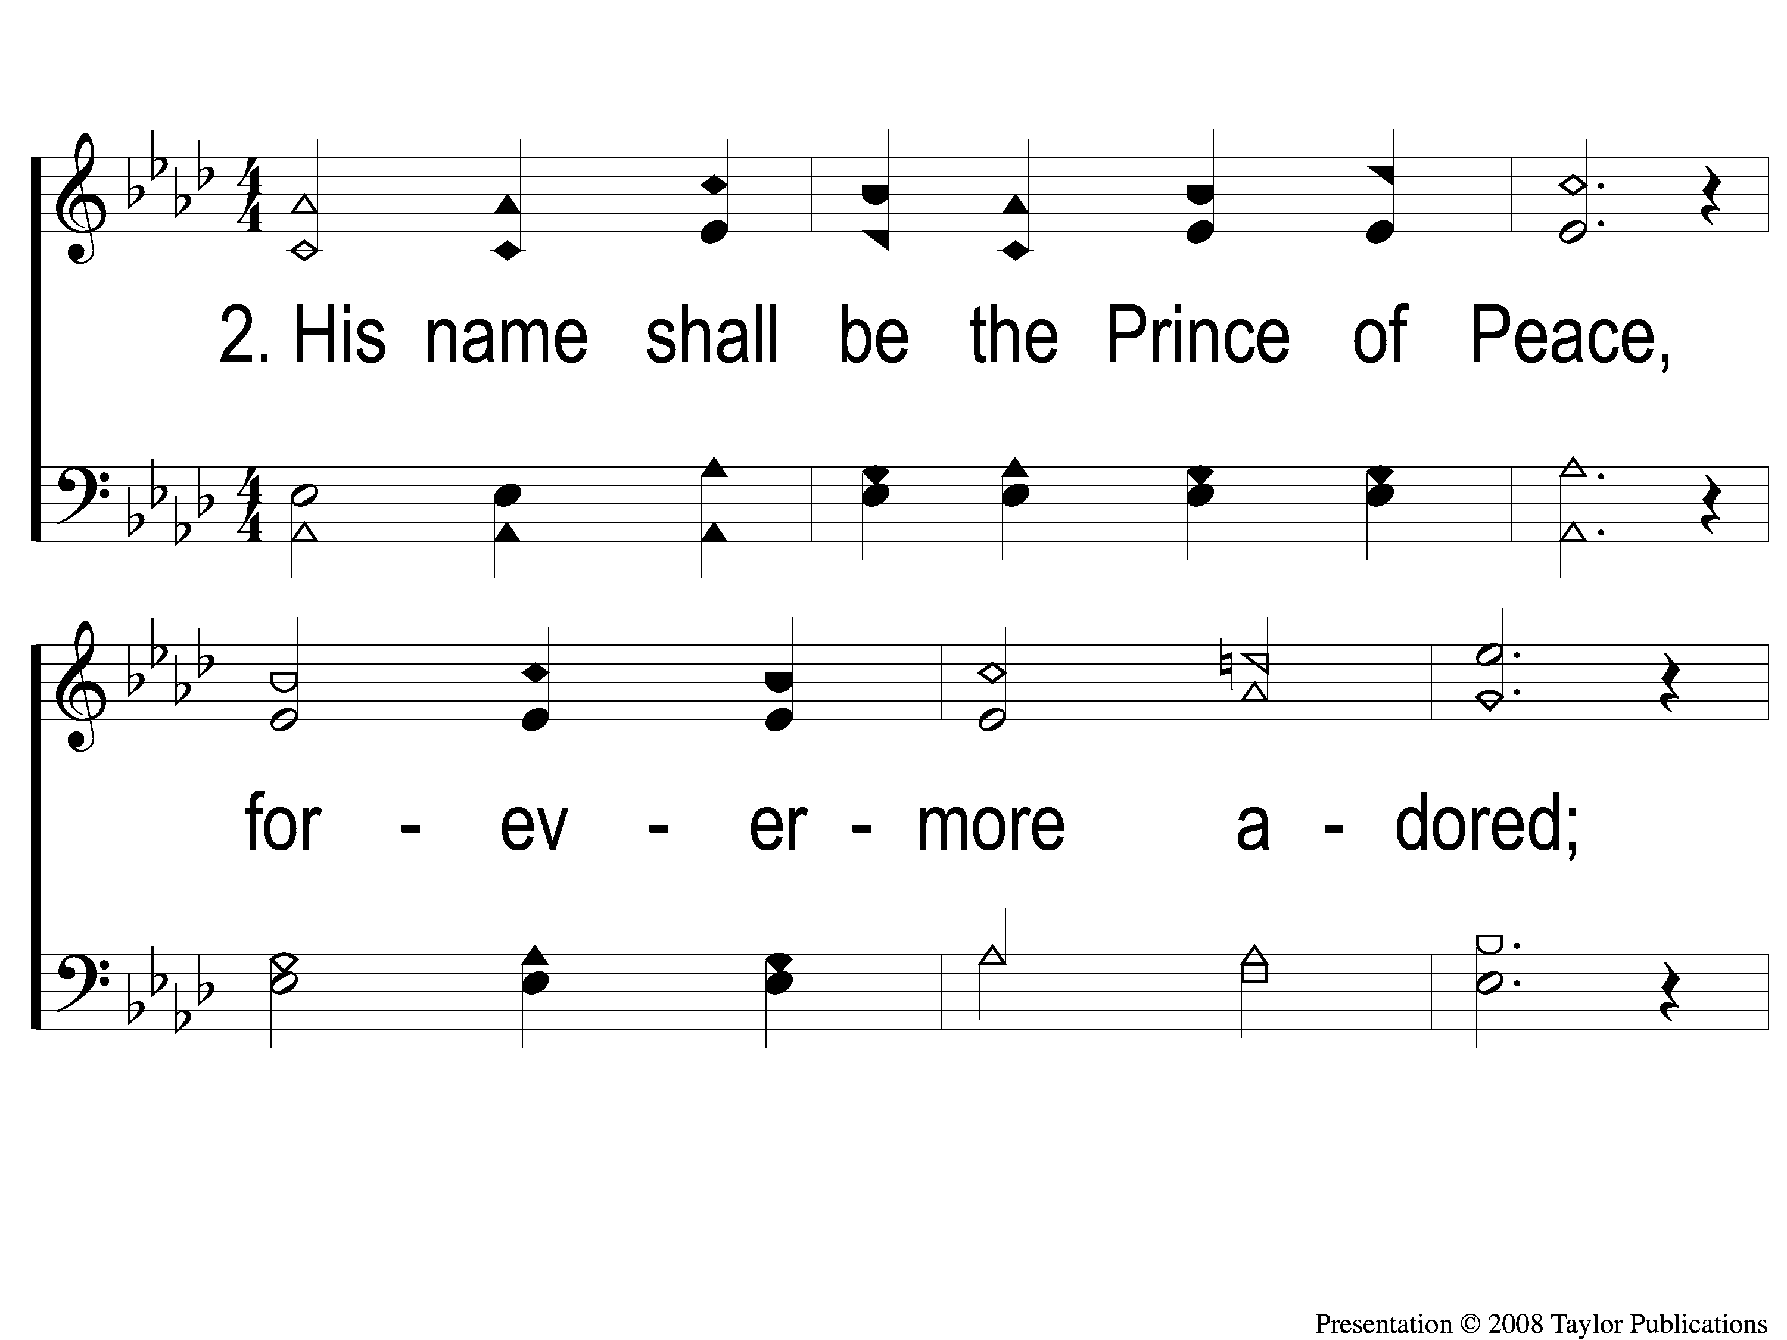
2-1 The Prince of Peace
The Prince of Peace
49

Slide 4
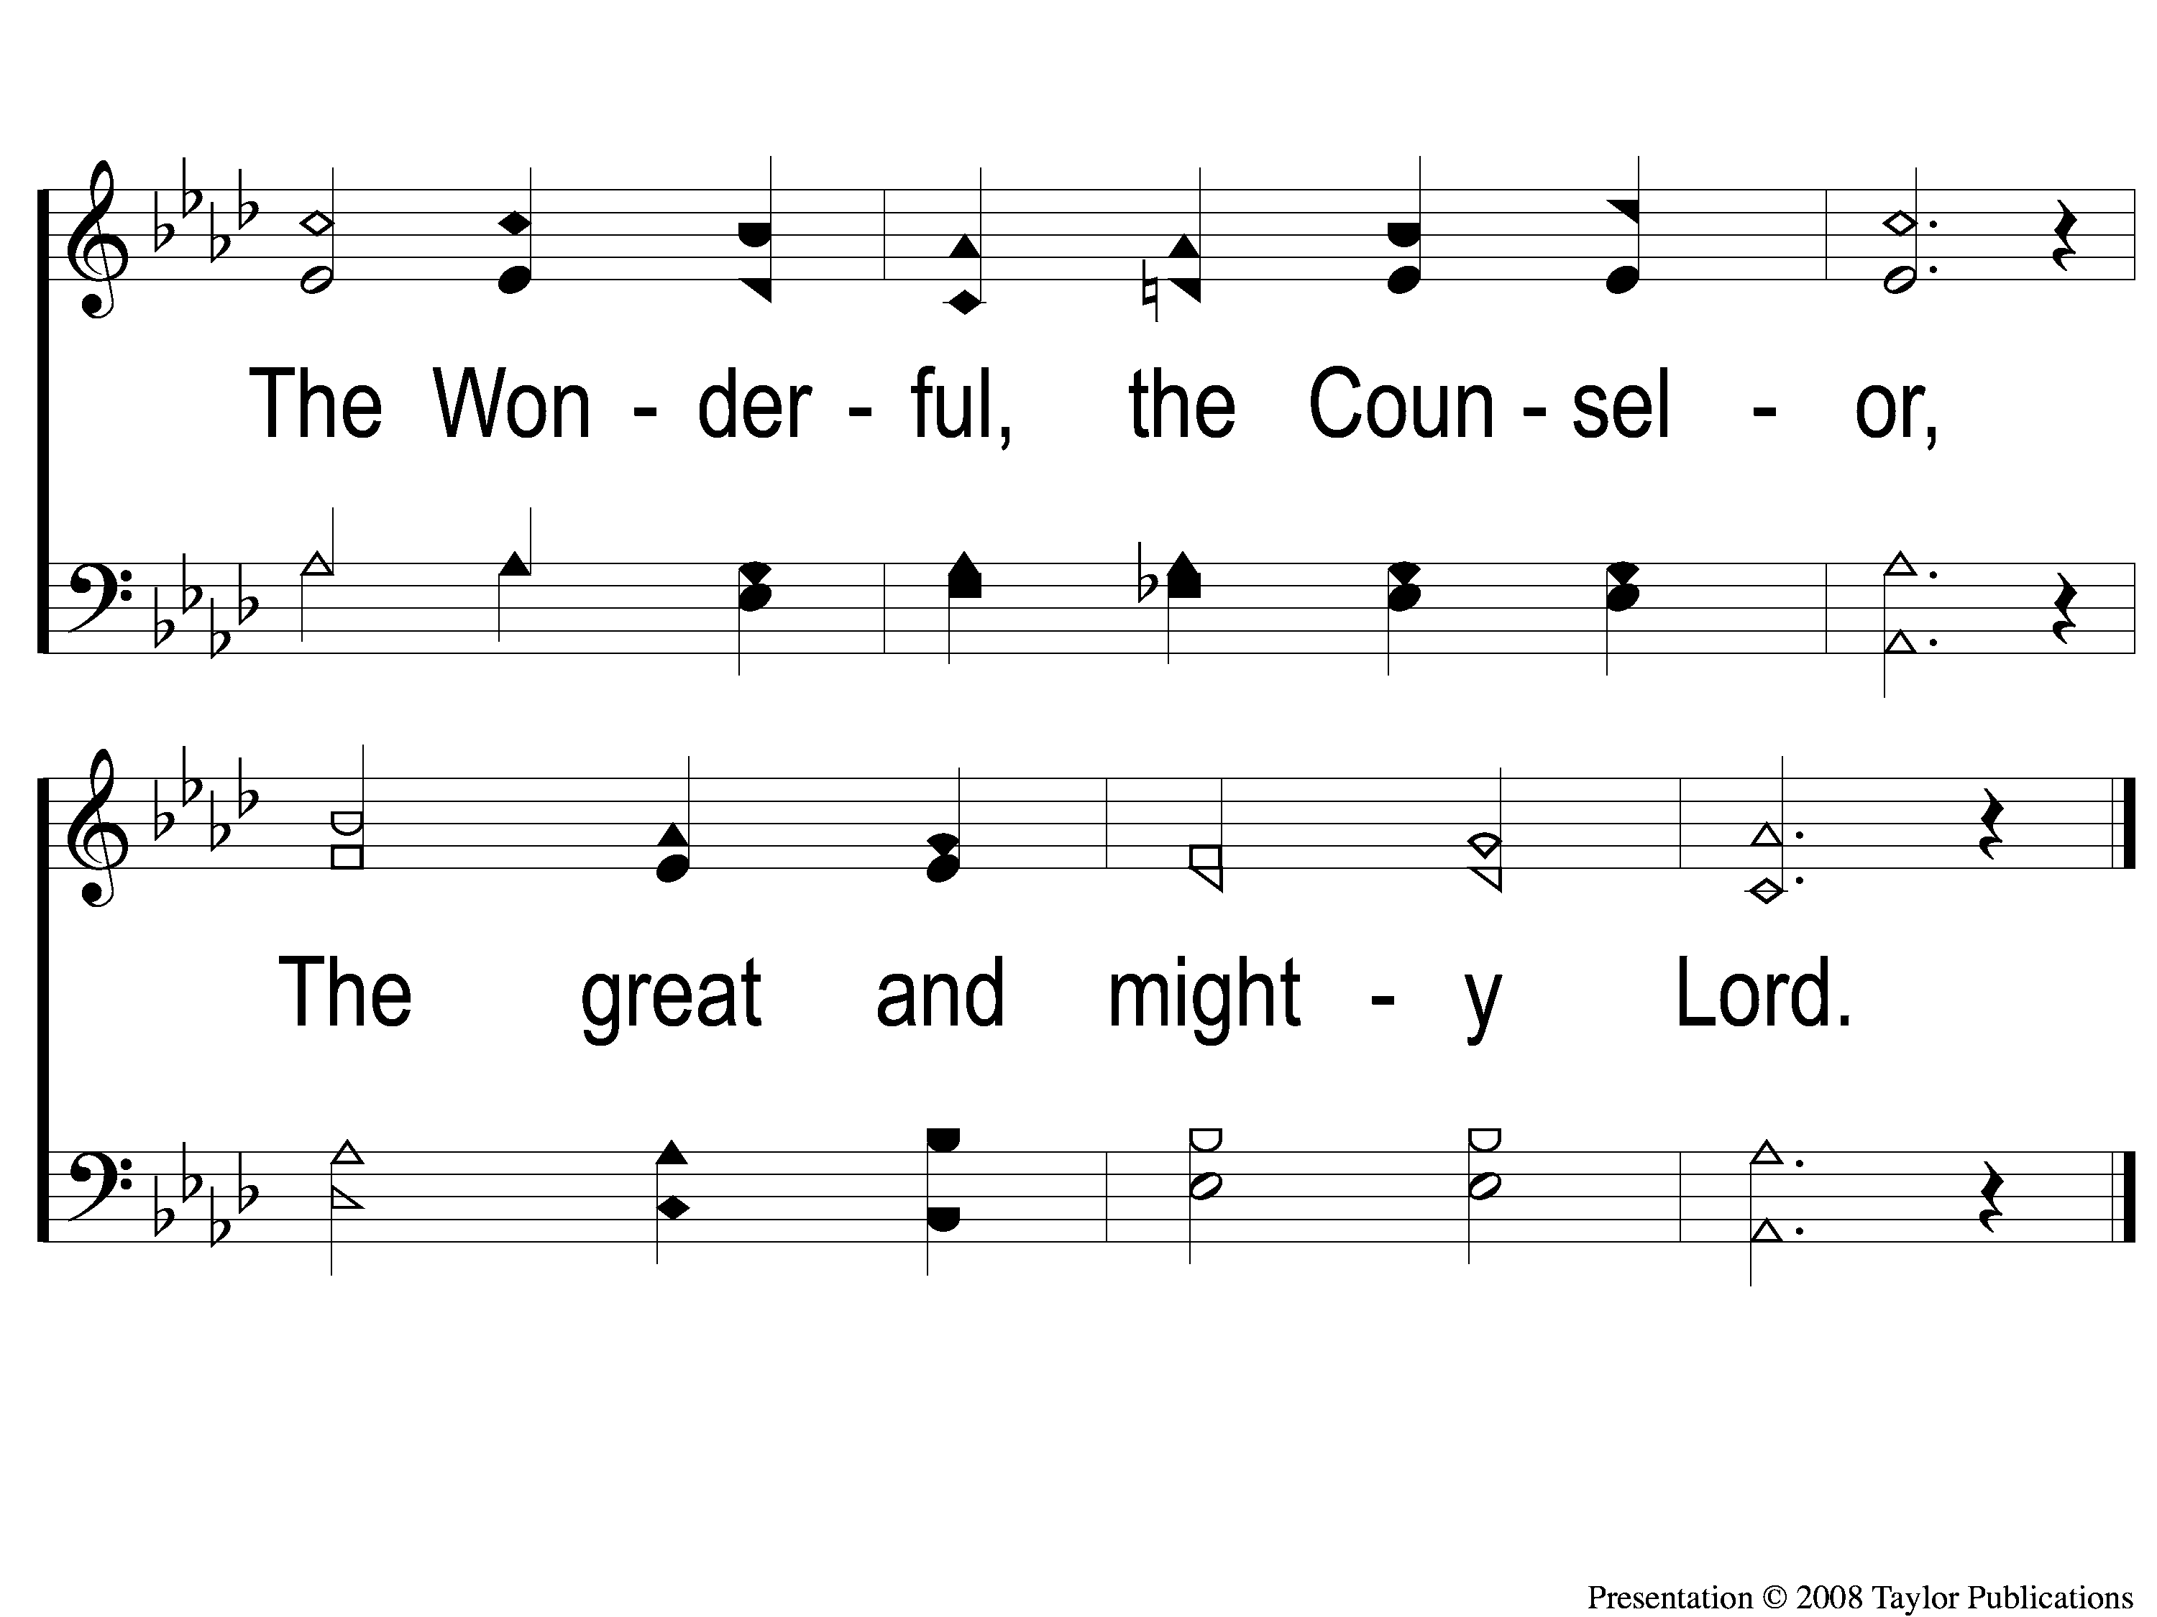
2-2 The Prince of Peace
The Prince of Peace
49

Slide 5
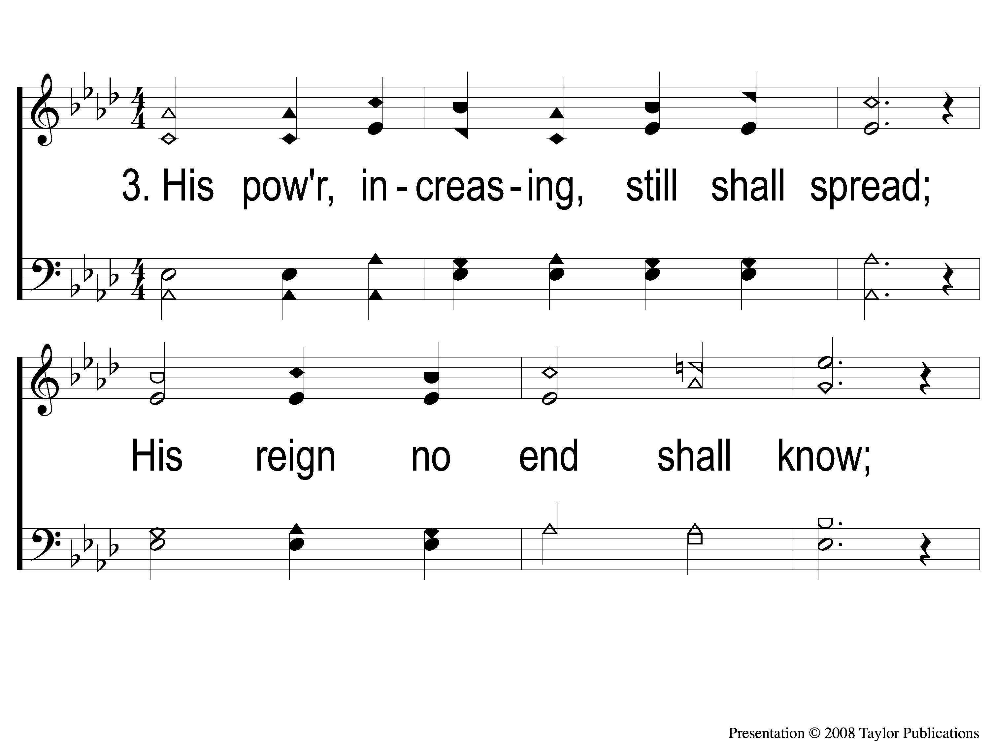
3-1 The Prince of Peace
The Prince of Peace
49

Slide 6
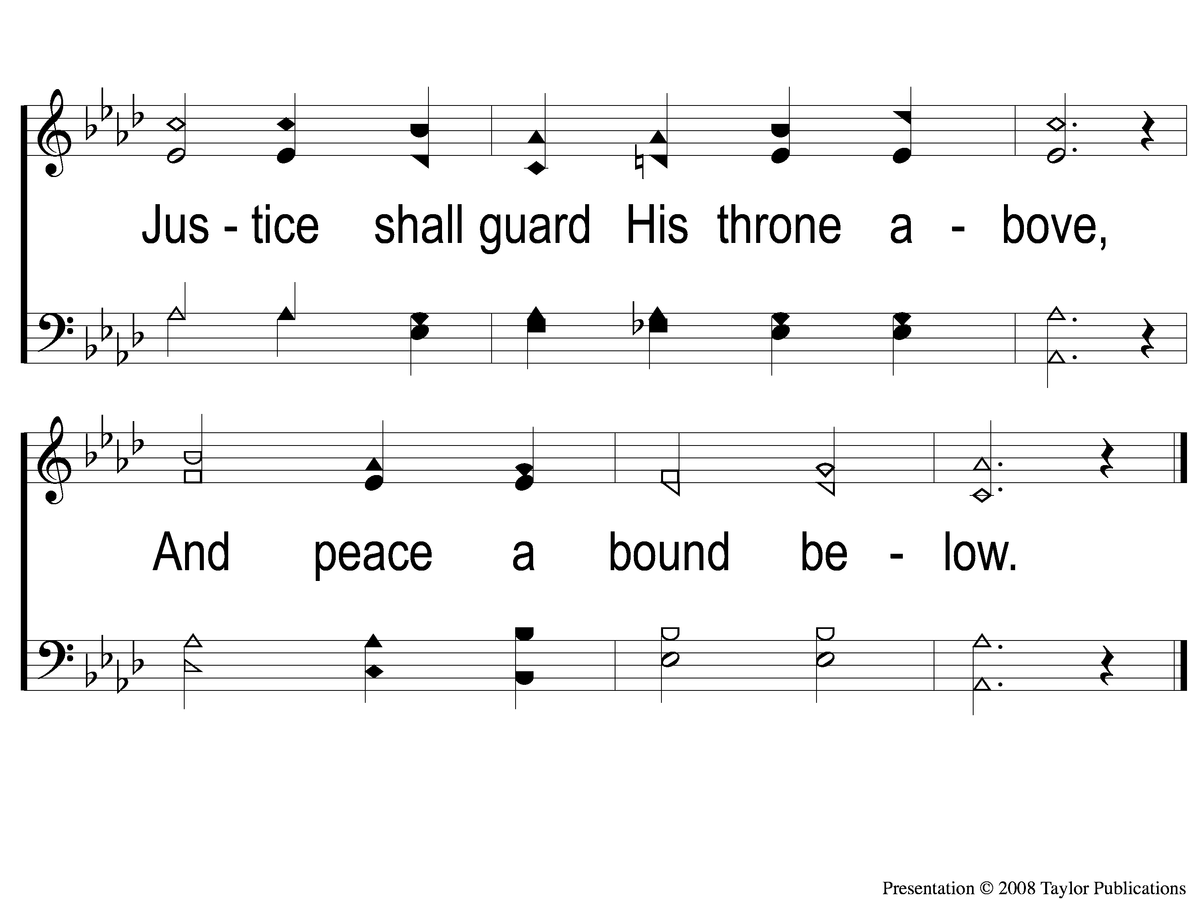
3-2 The Prince of Peace
The Prince of Peace
49

